Slide 1
Silver Leaf Solutions
Company Profile
Notes:
For information on applying this template to an existing presentations, refer to the notes on slide 2 of this presentation.
The Input area of the Beam can be customised to reflect the content of the
presentation. The Input area is an AutoShape with a picture fill. To change this, ensure you have the image you wish to use (ideally a .jpg or a .png file) in an accessible folder. The image should have a ratio of 1:1 to ensure it does not appear distorted. It is not possible to reposition the image within the Input area.
Acceptable images for importing into the Input area of the Beam are the three approved graphics (lines), and black and white photography or illustrations which follow the principles laid out on The Branding Zone. Colour images should never be imported into this area. Please be aware that replacing the Input area with high resolution graphics will significantly increase the file size. Contact your local DDC for assistance with updating the Beam.
Customise the Input area of the Beam as described below.
Click on the View tab from the menu bar and select Master>Slide Master
Right-click on the Input graphic and select Format AutoShape
From the Fill menu, under the Colour and Lines tab, click on the drop-down arrow next to Colour and select the Fill Effects menu
From the Picture tab, click on Select Picture. Navigate to the folder containing the image you wish to insert in the Input area. Highlight the image and tick the Lock picture aspect ratio box. Click on OK
You can now preview the image before continuing. If you are happy with how it looks, click OK to continue. Otherwise, repeat the process until you are happy with your selected image
To exit from Master View, click on View>Normal. The change you made to the Input graphic should now be visible on the title slide.

Slide 2
Agenda
1
Our Vision
2
Key Facts about Silver Leaf Solutions
3
Our Value Proposition
4
We Know Your Challenges
5
Our Services & Solutions Portfolio
6
Key Global Alliances & Partnerships
slide <number>
AT&T Proprietary (Internal Use Only)
Notes:
It is possible to apply this template to exiting presentations.
Have the latest presentation template open
Click on the View tab and select Normal
Delete all unwanted slides
Click on the Insert tab from the menu bar and select Slides from Files
Click on Browse. Navigate to the presentation you wish to update with the new template. Highlight the presentation and click Open
Wait for the slides from the presentation to load and click on Insert All. Then click Close
Check the inserted slides to ensure that the most appropriate master slide has been used on each slide
To change the master applied to a slide select the slide you wish to apply a different master to then click on the Format tab from the menu bar and select Slide Design
From the Used in This Presentation section choose the master you wish to apply to the slide and hover over it to reveal a drop-down arrow. Click on the arrow and select Apply to Selected Slides
Please note that the formatted Slide Master may differ from the source file so it is important to thoroughly check the presentation to ensure that no further formatting is needed.

Slide 3

About Silver Leaf Solutions | Our Vision
    To enable business leaders with
    forward-thinking and simplified approach that helps drive efficient and effective IT decisions
slide <number>
AT&T Proprietary (Internal Use Only)

Slide 4
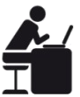





About Silver Leaf Solutions | Key Facts
Incorporated in July 2015
Privately owned
Founders from Microsoft, HP, EY, SAP, BCG, HCL and DLink
Global HQ: Gurgaon, India
Global offices:
US, UK
Domestic offices:
NCR, Mumbai & Bangalore
slide <number>
AT&T Proprietary (Internal Use Only)

Slide 5


About Silver Leaf Solutions | Our Value Proposition
First Global Company to Enable Enterprises with Software Licensing
Independent Advisory Services
Key Partnerships Delivering Customer Centric Software Solutions
In-depth Expertise on Cloud Solutions
Global Sourcing
AT&T Proprietary (Internal Use Only)

Slide 6










We Know Your Challenges…
… and offer solutions that fit!
Shrinking
IT budgets
Quick technology changes
Tax optimized purchasing
Process efficiency
Cost optimization
Legal certainty
Change
management
Company growth
Number of software providers
Increasing customer expectations

Slide 7















Our Services & Solutions Portfolio
ADVISORY
IT SERVICES
STRATEGIC RESELLING
AT&T Proprietary (Internal Use Only)

Slide 8
Our Services & Solutions Portfolio
      Evaluation of Existing Licensing Portfolio
      Licensing Transparency and Cost Reduction
      Contract Evaluation & Optimization Services
      Alignment of Software Spend with IT Roadmap
      Benchmarking RFP and Negotiation Support
AT&T Proprietary (Internal Use Only)

Slide 9
Our Services & Solutions Portfolio
      Software Asset Management – Standard & Recurring Services
      Software Audit Protection Services
      Risk Reduction & Compliance
      Asset Management Roadmap & Vision
      Application Usage Monitoring
AT&T Proprietary (Internal Use Only)

Slide 10

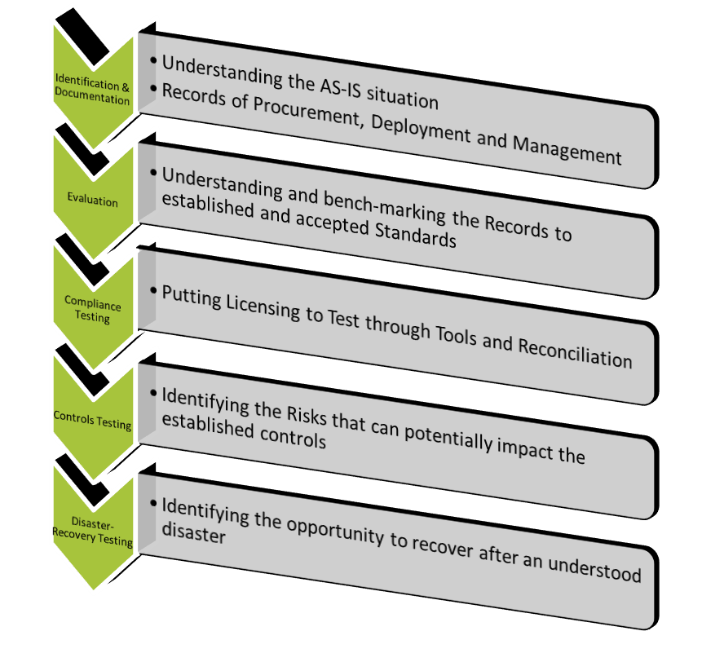
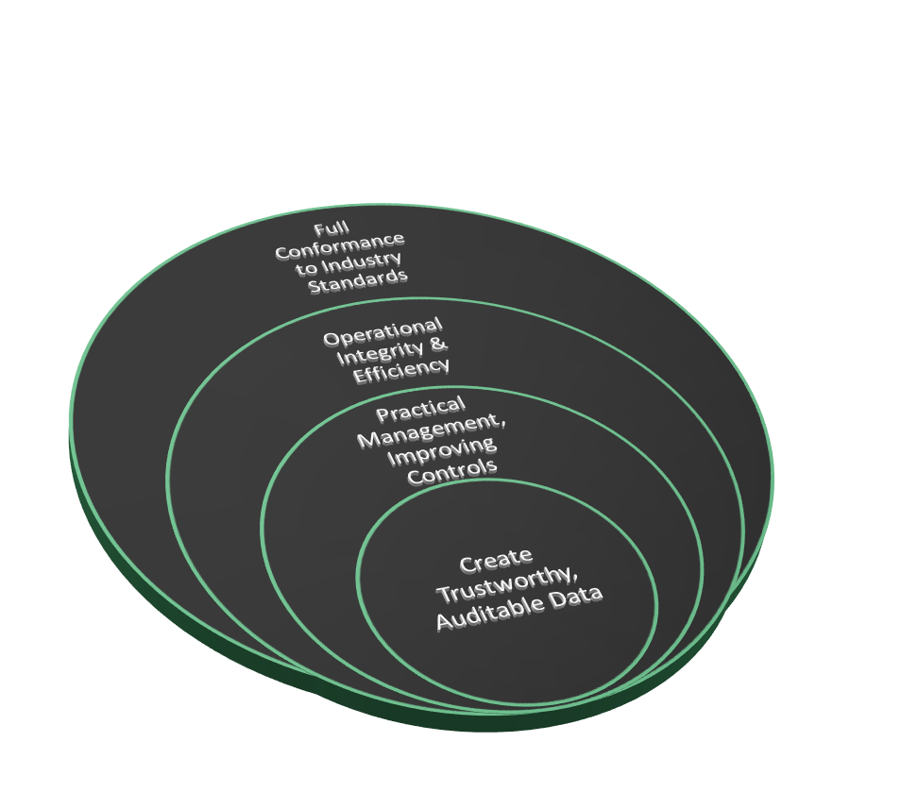
How do we help our customers…
AT&T Proprietary (Internal Use Only)

Slide 11
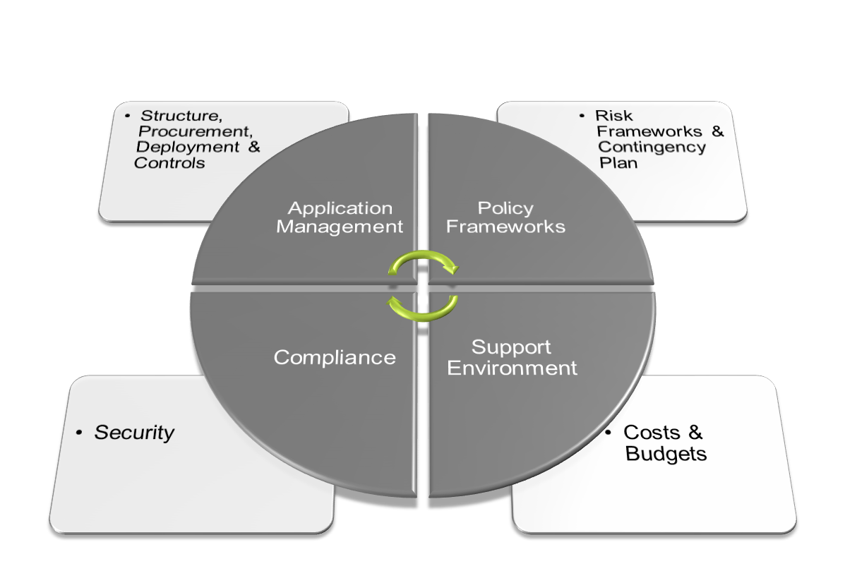
The Process-based tooling approach…
AT&T Proprietary (Internal Use Only)

Slide 12
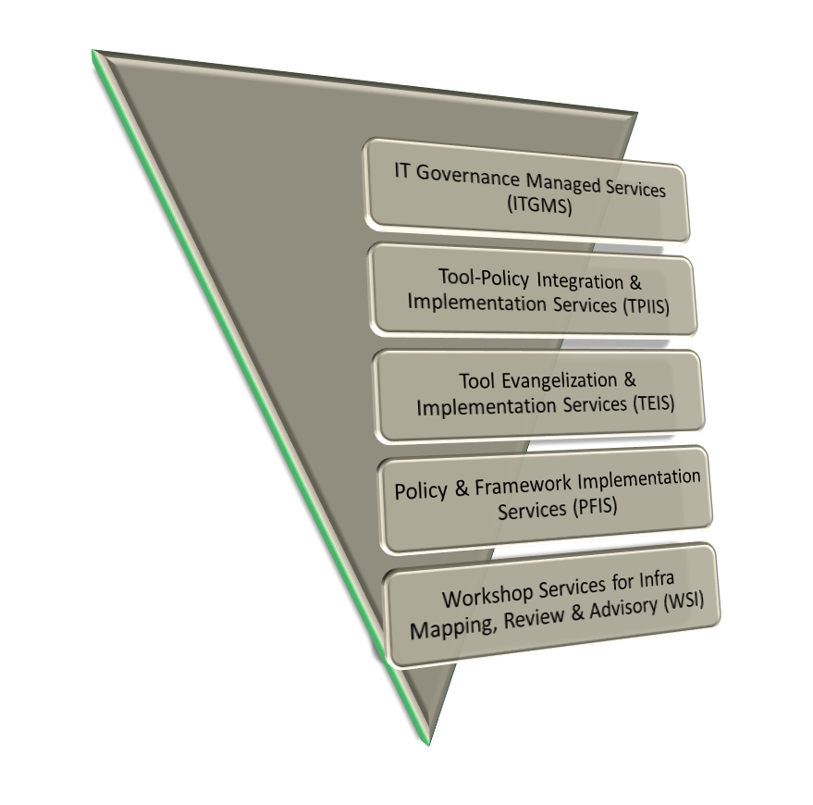
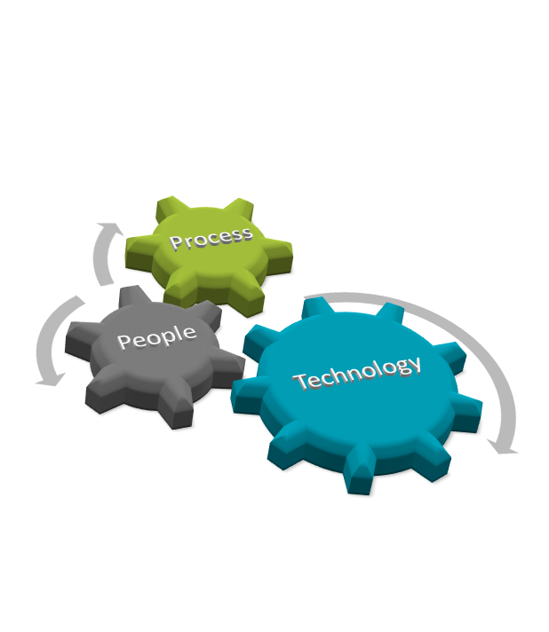

Know our services…
AT&T Proprietary (Internal Use Only)

Slide 13
Our Services & Solutions Portfolio
      Tail End / Industry Specific Software Procurement Services
      Real Time Online Portal for Software Licenses
      Price Benchmarking Services
      Tax Optimized Sourcing
      Supplier & Contract Management
AT&T Proprietary (Internal Use Only)

Slide 14
Our Services & Solutions Portfolio
      Cloud- Proof of Concept(POC) Based Services
      Cloud Readiness- Assessment Exercise
      Cloud Security Advisory Services
      Cloud Solution Evangelization & Sourcing
      Cloud Services Design & Transition
      Migration Assistance
AT&T Proprietary (Internal Use Only)

Slide 15
Our Services & Solutions Portfolio
      Network Integration/Upgrade Advisory Services
      Network Architecture Design Services
      Network Assessment & Discovery Workshop
      Networking Strategy & Optimization Services
      Network Auditing Services
AT&T Proprietary (Internal Use Only)

Slide 16
Our Services & Solutions Portfolio
      Technology Adoption Workshop
      Industry/ Vertical Specific Business Solutions
      Solutions- Proof Of Concept (POC)
      Solution Discovery & Evaluation
      Solution Architecture & Design
      IT Roadmap – Design & Advisory Services
AT&T Proprietary (Internal Use Only)

Slide 17
Our Services & Solutions Portfolio
      Software Installation and Version Upgrade
      Application Compatibility & Migration Services
      Network Integration Services
      Workload Transition
      Consumption Support Services
      Data Migration And Backup Services On Cloud
AT&T Proprietary (Internal Use Only)

Slide 18
Our Services & Solutions Portfolio
      24x7 Software Licensing Help Desk
      Technical support
      Technology and Licensing Workshops
      Certifications
      Skillset assessment & Evaluation
AT&T Proprietary (Internal Use Only)

Slide 19
Our Services & Solutions Portfolio
      Software License Fulfillment
      Software Spend Management & Outsourcing
      SLA based services
      Network Hardware Fulfilment (LAN, WAN & Security Solutions)
AT&T Proprietary (Internal Use Only)

Slide 20
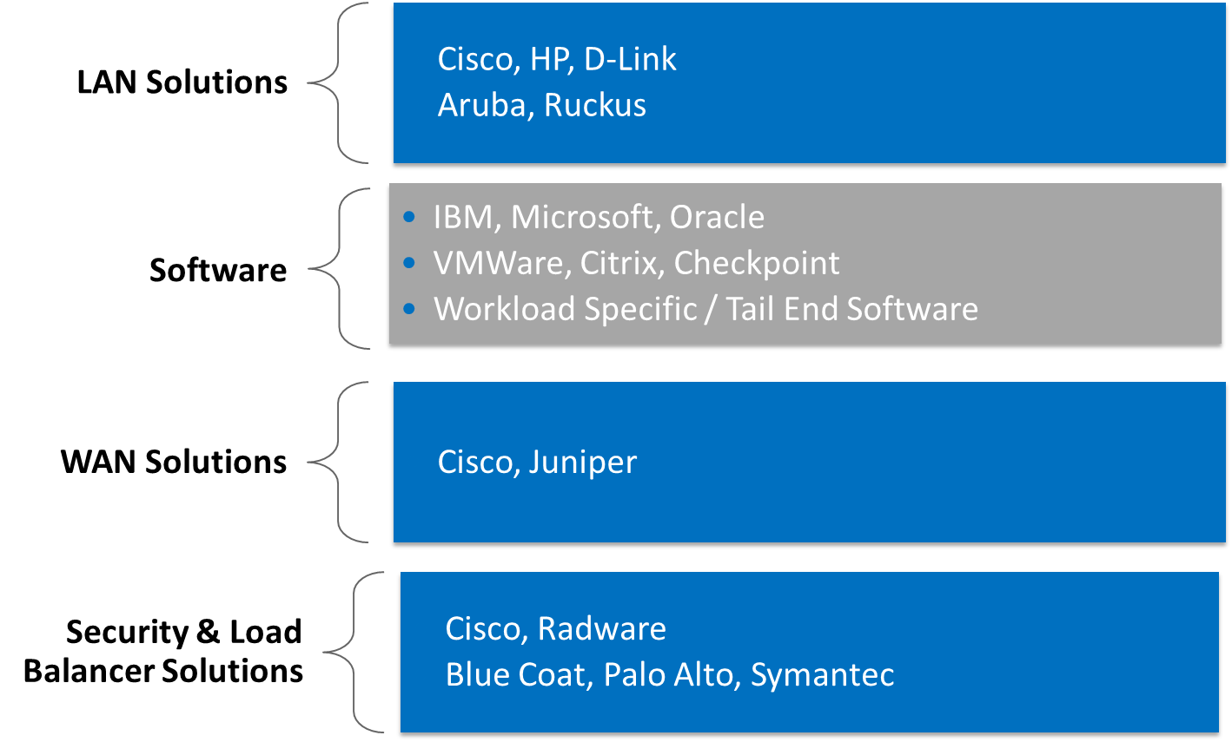
Key Global Alliances & Partnerships
AT&T Proprietary (Internal Use Only)

Slide 21
www.silverleafsolutions.in
Our Current Offices
Gurgaon
510, Vipul Trade Center,
Sector 48, Sohna Road, Gurgaon, Haryana, 122018
O: +91-124-2222197
Mumbai
8th Floor, A wing, Reliable Tech Park, Behind Reliable Plaza, Off Thane-Belapur Road,
Airoli, Navi Mumbai, 400708
O: +91 22 6687 4707
Bangalore
1st & 2nd Floor IBIS Hotel 26/1 Hosur Road, Bangalore , 560068
O: +91 80 67027161
Delhi
Level 2, KLJ Tower North,
B5 District Centre
Netaji Subash Place,
New Delhi, 110034
O: +91 11 66481080

